Slide 1


SRI RAMAKRISHNA INSTITUTE OF TECHNOLOGY
(An Autonomous Institution)
Pachapalayam, Perur Chettipalayam, Coimbatore- 641 010
DEPARTMENT OF COMPUTER SCIENCE AND ENGINEERING
20CS902-FYP Phase I EXAM PRESENTATION
BATCH NO : 26
REPUTATION - BASED OPPURTUNISTIC ROUTING PROTOCOL USING Q-LEARNING FOR MANET ATTACKED BY MALICIOUS NODES
Presented by:
KABIR AHMED M 71382102065
KAVIN THAMIL A 71382102073
PRADEEP S 71382102113
Guided by:
Dr. KAVITHA N S
Associate Professor
Department of CSE

Slide 2
Content Outline
Abstract
Architectural Design
Data Flow Diagram
Algorithms/Techniques
Expected Outcomes
Experimental Results
Performance Evaluation
Comparison with Existing System
Future Work
Conclusion
References

Slide 3
ABSTRACT
Routing in networks, especially MANETs, is challenging due to their flexible and decentralized nature. The presence of malicious nodes complicates routing further.
This project introduces a reinforcement learning-based routing protocol called reputation opportunistic routing based on Q-learning (RORQ).
RORQ integrates game theory and a reputation system to identify and exclude malicious nodes, enhancing routing efficiency.
The proposed protocol demonstrates superior performance compared to existing methods in terms of packet loss, end-to-end delay, and energy efficiency, especially against blackhole and gray hole attacks.

Slide 4
ARCHITECTURAL DESIGN
MANET Environment
RORQ Protocol
Routing Decision Module
Reinforcement Learning
Reputation System
Game Theory Model
Q-learning Algorithm
Node Evaluation
Strategy Formulation
State-Action Mapping
Reputation Scoring
Payoff Calculation
Path Selection
Malicious Node Exclusion
Network Monitoring
Performance Metrics
Node Behaviour Analysis
Q-Value Updates
BLOCK DIAGRAM

Slide 5
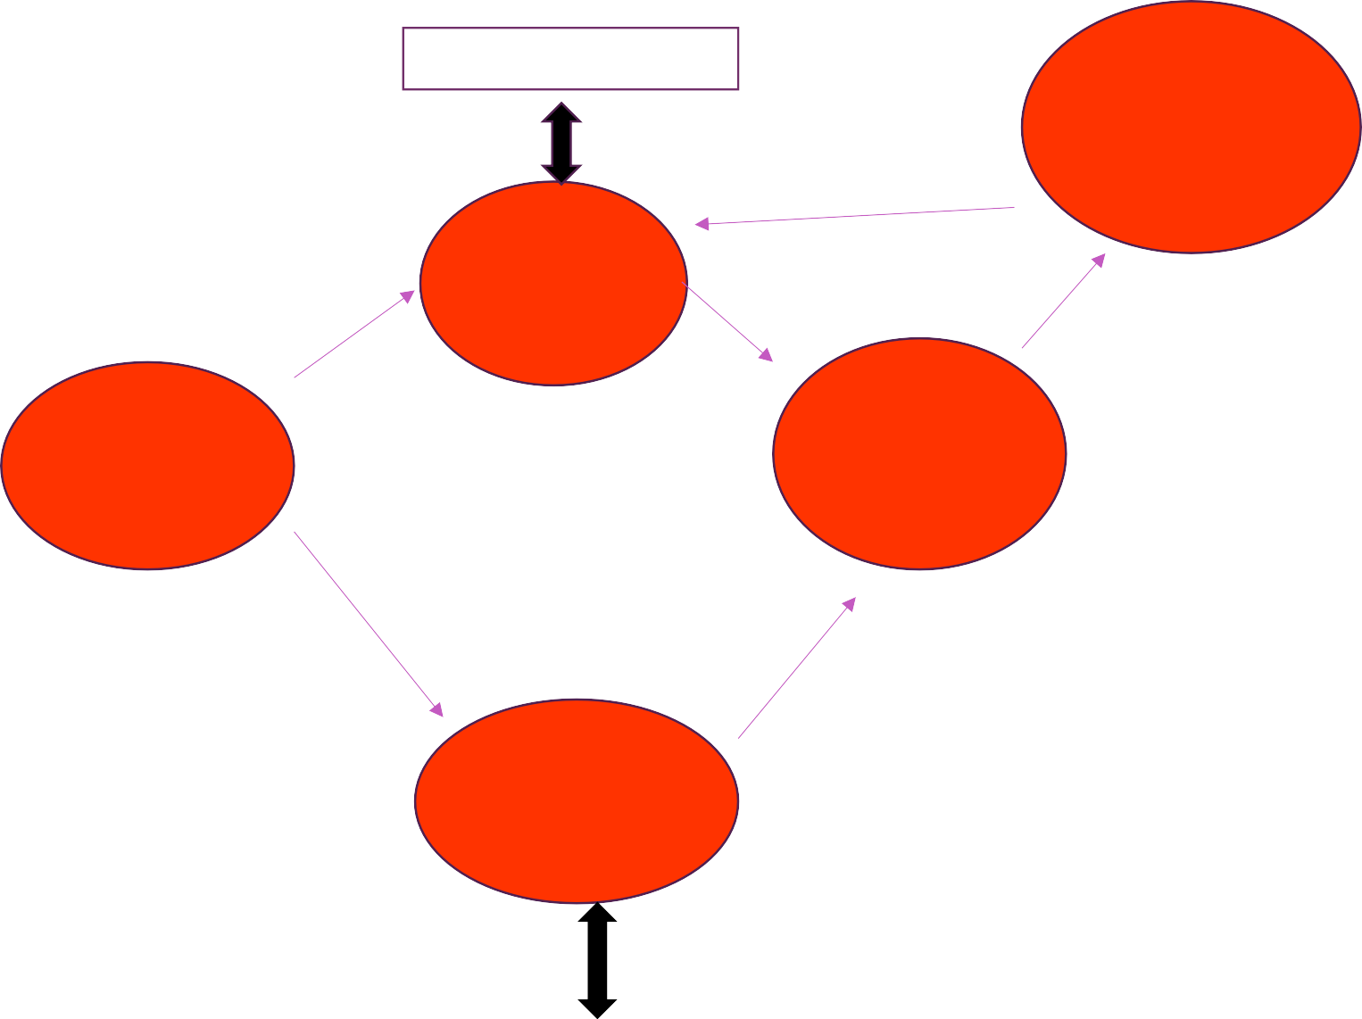
DATA FLOW DIAGRAM
Q-Table
Retrieve Q-Value Update Q-Value
5.Performance Monitoring
Performance metrics
State info
2.Q-Learning
Algorithm
Q-Values
Selected routes
Destination
Route Request
4.Route Selection
Node
1.Root Request
Data packets
Source Node
Node Reputations
Node list
3.Reputation Evaluation
Retrieve Score
Update Score
Reputation Score

Slide 6
ALGORITHMS\TECHNIQUE USED
1) Q-Learning (Reinforcement Learning)
This algorithm evaluates and updates the reputation of each node based on its past behavior, such as successful packet delivery and response times, to ensure reliable routing paths.
2)Q-Learning Algorithm
A reinforcement learning approach where nodes learn optimal routing strategies by updating a Q-table.The Q-table is adjusted based on rewards received from successful transmissions and the reputation of neighboring nodes.

Slide 7
Contd..
3) Threshold-Based Malicious Node Detection
This algorithm identifies and isolates nodes with reputations below a certain threshold, preventing them from participating in routing to enhance network security.
4) Dynamic Action Selection Algorithm
Selects the next hop in the routing process by dynamically choosing nodes with the highest reputation scores,
aiming to maximize successful data delivery and minimize disruptions.

Slide 8
EXPECTED OUTCOMES
Improved Network Efficiency :
By dynamically selecting trusted nodes, the protocol optimizes routing paths, reducing overhead and enhancing network performance.
Adaptive and Intelligent Routing :
The Q-learning mechanism enables continuous adaptation to network changes, allowing the system to refine its routing decisions based on real-time data.
Optimized Energy Consumption :
By selecting efficient paths and minimizing unnecessary retransmissions, the protocol conserves energy, extending the network’s operational lifespan.
Scalability and Robustness :
The approach remains effective as network size grows, maintaining high packet delivery rates and low latency even in larger, more dynamic MANET environments

Slide 9
EXPERIMENTAL RESULTS
The Q-learning-based routing protocol improves packet delivery ratio by ensuring data is forwarded through reliable nodes, reducing packet loss. Python simulations show a decrease in end-to-end delay by selecting optimal paths and avoiding malicious nodes, leading to faster communication.
The threshold-based malicious node detection mechanism accurately isolates attacks, enhancing network security. Additionally, the protocol optimizes energy efficiency by minimizing unnecessary transmissions. Over time, the Q-learning mechanism adapts, refining routing decisions and ensuring scalable, robust performance in dynamic environments.

Slide 10
EXPERIMENTAL RESULTS

Slide 11
Contd..
The image depicts a network simulation that showcases the application of reinforcement learning, specifically Q-learning, in a mobile ad-hoc network (MANET) environment. The network is represented by a grid of nodes, some of which are highlighted in red, indicating the presence of malicious nodes that can disrupt the network's performance.
The blue lines in the image represent the routing path determined by the Q-learning algorithm, which aims to navigate the network while avoiding the malicious nodes. This approach demonstrates the potential of reinforcement learning techniques to enable resilient and efficient data transmission in MANET settings, where the presence of malicious nodes can pose significant challenges to the overall network's reliability and performance.
The Q-learning algorithm learns from the network's dynamics and adapts its routing decisions accordingly, seeking to minimize the impact of malicious nodes and ensure reliable data delivery. This simulation showcases the integration of machine learning and networking principles, highlighting the promising applications of reinforcement learning in the context of mobile ad-hoc networks, where the dynamic and decentralized nature of the environment requires adaptive and intelligent routing strategies.

Slide 12
PERFORMANCE EVALUATION
The routing protocol improves packet delivery by routing data through reliable nodes, reducing packet loss. Simulations show a decrease in end-to-end delay by selecting optimal paths and avoiding malicious nodes, leading to faster communication.Energy efficiency is enhanced by minimizing redundant transmissions, conserving network resources. The threshold-based malicious node detection effectively isolates harmful nodes, boosting security and preventing attacks. Overall, the protocol outperforms traditional methods in reliability, efficiency, and security for dynamic networks like MANETs..

Slide 13
COMPARISON WITH EXISTING SYSTEMS
FEATURES | EXISTING SYSTEM | PROPOSED SYSTEM
Routing Protocol | Traditional routing protocols, such as AODV (Ad hoc On-Demand Distance Vector) and DSR (Dynamic Source Routing), typically used in MANETs. | Reputation-based opportunistic routing using Q-learning to improve route reliability and adaptiveness.
Malicious Node Detection | Limited or no mechanisms to detect malicious nodes effectively; mostly relies on pre-set security rules. | Q-learning-based adaptive mechanism to identify and avoid malicious nodes based on reputation scores.
Learning Mechanism | No learning component; traditional routing methods don't adapt based on past experiences. | Uses Q-learning to dynamically learn and adjust routing decisions based on node behavior and reliability.
Reputation Management | Basic or no reputation management, potentially using static trust values if any. | A reputation system is integrated, where each node's reputation is updated based on packet forwarding behavior.
Response to Attacks | Reactive; only detects malicious activity after network performance is impacted. | Proactive; identifies and isolates malicious nodes through reputation-based metrics, minimizing attack impact.

Slide 14
FUTURE WORK
1) Extend the protocol to support multi-hop routing, enabling better scalability and performance in larger and more complex MANETs.
2) Implement a real-time adaptive mechanism that dynamically updates the reputation system based on changing network conditions and node behaviors.
3) Adapt the protocol to handle heterogeneous networks with diverse node types, such as mobile and static nodes, to enhance flexibility and versatility.
4) Integrate advanced security features, including encryption and intrusion detection, to further protect the network from sophisticated attacks and ensure data integrity.
5) Optimize the protocol for energy-harvesting nodes, enabling more efficient resource management and sustainable operation in networks that rely on renewable energy sources.

Slide 15
CONCLUSION
The Q-learning-based routing protocol effectively enhances the performance and security of MANETs by leveraging a reputation system to identify reliable nodes and avoid malicious ones. Through dynamic path selection, the protocol reduces packet loss, minimizes end-to-end delays, and optimizes energy efficiency. Its ability to detect and isolate malicious nodes improves network security, ensuring reliable data transmission. The integration of reinforcement learning allows the system to adapt and refine routing decisions over time, ensuring scalability and robustness in dynamic environments. Overall, this protocol presents a promising solution for efficient, secure, and sustainable communication in decentralized networks.

Slide 16
REFERENCES
Zhu, Q. Jiang, X. Huang, D. Li, and Q. Yang, ‘‘A reinforcement learning-based opportunistic routing protocol for energy-efficient and void-avoided UASNs,’’ IEEE Sensors J., vol. 22, no. 13, pp. 13589–13601, Jul. 2022, doi: 10.1109/JSEN.2022.3175994.
B. Su, C. Du, and J. Huan, ‘‘Trusted opportunistic routing based on node trust model,’’ IEEE Access, vol. 8, pp. 163077–163090,
2020, doi: 10.1109/ACCESS.2020.3020129
Chen, K. Zheng, X. Fang, L. Wan, and X. Xu, ‘‘QMCR: A Q-learning based multi-hop cooperative routing protocol for underwater acoustic sensor networks,’’ China Commun., vol. 18, no. 8, pp. 224–236, Aug. 2021, doi: 10.23919/JCC.2021.08.016.
K. Tang, C. Li, H. Xiong, J. Zou, and P. Frossard, ‘‘Reinforcement learning based opportunistic routing for live video streaming over multi-hop wireless networks,’’ in Proc. IEEE 19th Int. Workshop Multimedia Signal Process. (MMSP), Oct. 2017, pp. 1–6, doi: 10.1109/MMSP.2017.8122255.

Slide 17
THANK YOU

